Slide 1
Operating System:
Abraham Silberschatz, Peter Baer Galvin, Greg Gagne Operating System
Principles, 8th edition Wiley- India,2011.
Shubha Malige
Asst. Professor
CSE(Cyber Security)
Dept. of CSE(CS), MSRIT

Slide 2
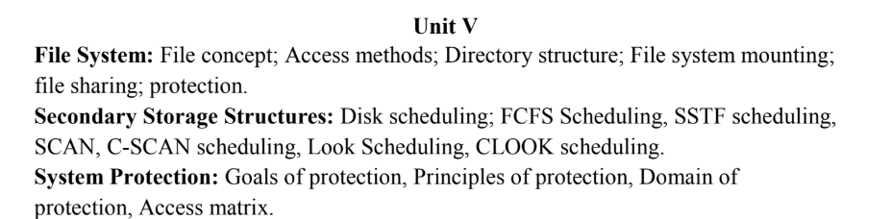
Dept. of CSE(CS), MSRIT

Slide 3
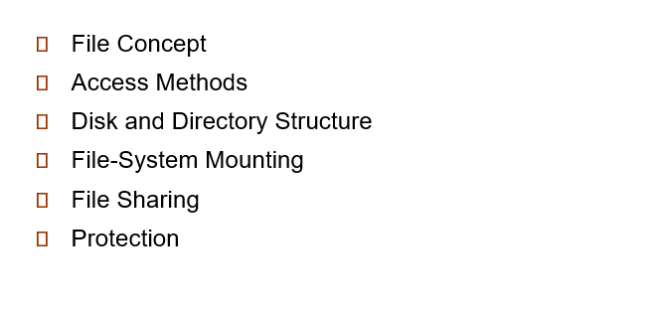
Dept. of CSE(CS), MSRIT

Slide 4
File Concept
Computers store information on different storage devices such as magnetic disks, magnetic tapes, and optical disks.
The operating system provides a uniform logical view of stored information so that the system is easy and convenient to use.
The operating system abstracts physical storage details and defines a logical storage unit called a file. Files are mapped onto physical storage devices.
Storage devices used for files are usually nonvolatile, meaning the data remains stored even after the system is rebooted.
A file is a named collection of related information stored on secondary storage. Data must be stored inside a file; it cannot be written directly to secondary storage without being part of a file.
Files can store programs or data (numeric, text, binary, etc.). They may be free-form (like text files) or strictly formatted. A file is generally a sequence of bits, bytes, lines, or records, and its structure depends on its type (e.g., text file, source file, executable file).
Dept. of CSE(CS), MSRIT

Slide 5
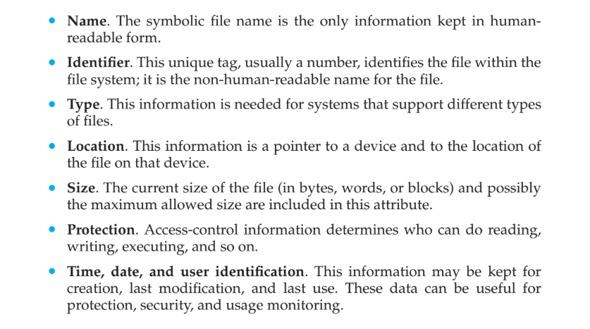
File Attributes
Dept. of CSE(CS), MSRIT

Slide 6
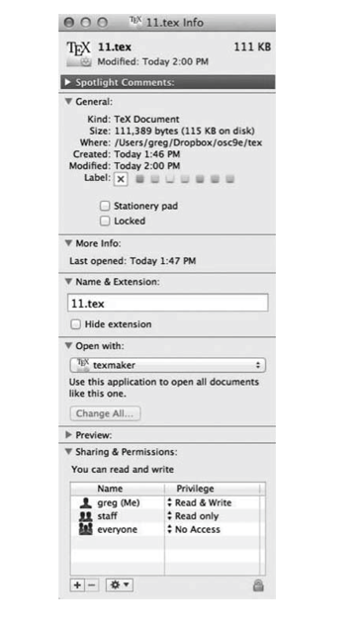
File Info Window On MacOS X
Dept. of CSE(CS), MSRIT

Slide 7
File Attributes
All file information is kept in the directory structure stored on secondary storage. A directory entry typically contains the file’s name and a unique identifier, which is used to locate the other file attributes. Storing this information for each file may require more than a kilobyte, and in systems with many files, the directory size can reach megabytes.
Since directories must be nonvolatile like files, they are stored on the storage device and are brought into memory in parts (piecemeal) as needed.
Dept. of CSE(CS), MSRIT

Slide 8
File Operations
A file is considered an abstract data type, and to define it properly, we must consider the operations that can be performed on it.
The operating system provides system calls to perform six basic operations: create, write, read, reposition, delete, and truncate files. Other operations, such as renaming a file, can be implemented based on these basic operations.
Creating a file – The system finds space in the file system and creates a new directory entry for the file.
Writing a file – The system locates the file, writes data to it, and updates the write pointer after each write operation.
Reading a file – The system locates the file, reads data from it into memory, and updates the read pointer after each read.
Repositioning within a file (Seek) – The system moves the current file-position pointer to a specified location without performing actual I/O.
Deleting a file – The system removes the file’s directory entry and releases its allocated space for reuse.
Truncating a file – The system clears the file’s contents while keeping its attributes unchanged and releases its space.

Slide 9
File Operations
Basic file operations can be combined to perform tasks such as copying a file. Systems also provide operations to get and set file attributes, such as file length and owner.
Since many file operations require searching the directory, most systems require an open() system call before using a file. The operating system maintains an open-file table, and file operations use an index to this table instead of repeatedly searching the directory.
The open() call searches the directory, copies the directory entry into the open-file table, checks access permissions (read, write, append, etc.), and returns a pointer to the open-file table entry. The close() call removes the file entry when it is no longer in use. The create() and delete() calls operate on closed files.
Some systems automatically open a file on first reference and close it when the program ends. However, most systems require programmers to explicitly open a file using open() before using it.
In systems where multiple processes may open the same file, two tables are used: a per-process table (stores process-specific details like current file pointer and access rights) and a system-wide table (stores file location, size, access dates, etc.). An open count tracks how many processes have the file open, and the file is removed from the table when the count reaches zero.
Dept. of CSE(CS), MSRIT

Slide 10
File Operations
The other pieces of operation associated with file are:
File pointer. On systems that do not include a file offset as part of the read() and write() system calls, the system must track the last read–
write location as a current-file-position pointer. This pointer is unique to each process operating on the file and therefore must be kept separate from the on-disk file attributes.
File-open count. As files are closed, the operating system must reuse its open-file table entries, or it could run out of space in the table. Multiple
processes may have opened a file, and the system must wait for the last file to close before removing the open-file table entry. The file-open count
tracks the number of opens and closes and reaches zero on the last close. The system can then remove the entry.
Disk location of the file. Most file operations require the system to modify data within the file. The information needed to locate the file on disk is
kept in memory so that the system does not have to read it from disk for each operation.
Access rights. Each process opens a file in an access mode. This information is stored on the per-process table so the operating system can allow or deny subsequent I/O requests.
Dept. of CSE(CS), MSRIT

Slide 11
File Operations
Purpose of File Locks
Some operating systems allow locking of an open file (or parts of it) to prevent other processes from accessing it. This is useful when multiple processes share and modify the same file, such as a system log file.
Types of File Locks
File locks are similar to reader–writer locks: a shared lock allows multiple processes to access the file simultaneously (like a reader lock), while an exclusive lock allows only one process at a time (like a writer lock). Some systems provide only exclusive locking.
Dept. of CSE(CS), MSRIT

Slide 12
File Operations
Mandatory Locking
In mandatory locking, once a process acquires an exclusive lock, the operating system prevents any other process from accessing the locked file until the lock is released.
Advisory Locking
In advisory locking, the operating system does not enforce the lock. Instead, programs must be written to manually acquire and release locks before accessing the file.
Responsibility for Lock Integrity
With mandatory locking, the operating system ensures locking integrity. With advisory locking, it is the responsibility of software developers to properly manage locks.
System Differences
Generally, Windows operating systems use mandatory locking, whereas UNIX systems use advisory locking.
Precautions in Using File Locks
File locking requires the same care as process synchronization. Processes should hold locks only while accessing files and must avoid deadlocks when multiple processes attempt to acquire locks.
Dept. of CSE(CS), MSRIT

Slide 13
File Types
When designing a file system, it is important to decide whether the operating system should recognize and support file types so it can operate on files appropriately.
A common method to implement file types is by including the type as part of the file name, splitting it into a name and an extension separated by a period (e.g., resume.docx, server.c).
The file extension indicates the type of the file and the operations that can be performed on it. For example, .com, .exe, and .sh files can be executed.
Application programs use extensions to identify the files they process, such as .java for Java source files and .doc or .docx for Microsoft Word documents.
File extensions are not always required and may act as “hints” to applications, since they are not necessarily enforced by the operating system..
Dept. of CSE(CS), MSRIT

Slide 14
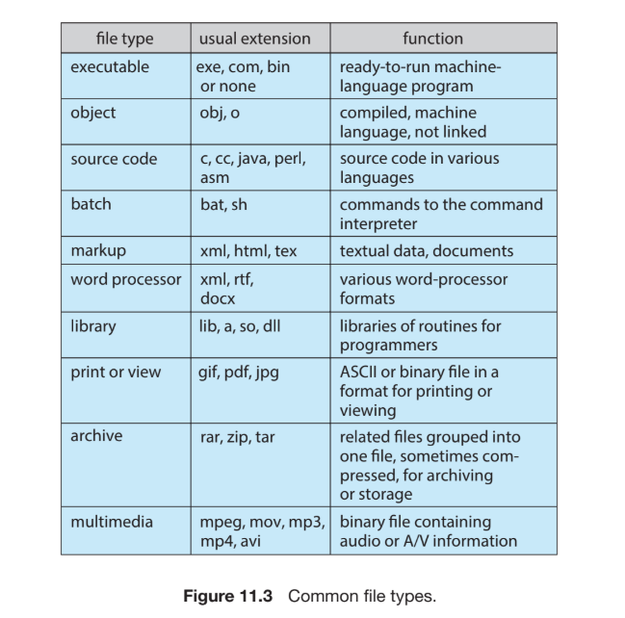
File Types
Dept. of CSE(CS), MSRIT

Slide 15
File Structure
File types can indicate the internal structure of a file, and some files—such as executable files—must follow a specific structure understood by the operating system so it knows how to load and run them.
Some operating systems support multiple file structures with special operations, but this increases the size and complexity of the operating system.
If the operating system supports only certain predefined file types, problems may arise when applications require new structures that are not supported.
For example, in a system supporting only text and executable binary files, an encrypted file may not fit either type, forcing users to misuse the file-type mechanism or abandon the idea.
To avoid such issues, systems like UNIX treat files simply as sequences of 8-bit bytes with no interpretation by the OS, giving maximum flexibility, although the OS must still support at least the structure of executable files.
Dept. of CSE(CS), MSRIT

Slide 16
Internal File Structure
Disks store data in fixed-size units called blocks, and all input/output operations are performed in these blocks.
The actual data inside a file (logical records) may not match the fixed physical block size, and logical records can even vary in length.
To handle this difference, logical records are packed into physical disk blocks, which solves the size mismatch problem.
In systems like UNIX, a file is treated as a sequence of bytes, where each byte has an offset, and the operating system automatically packs and unpacks these bytes into blocks (for example, 512 bytes per block).
All basic I/O operations work in terms of blocks, and the conversion from logical records to physical blocks is handled by software (either by the OS or the application).
Since disk space is allocated only in whole blocks, the last block of a file may not be fully used, leading to internal fragmentation, and larger block sizes cause more wasted space.
Dept. of CSE(CS), MSRIT

Slide 17
Access methods
Files store information, and when this information is needed, it must be accessed and read into memory. Different operating systems may support one or multiple access methods.
Sequential Access
Sequential access is the simplest and most common access method, where information is processed in order, one record after another.
Common Usage
Many programs such as editors and compilers use sequential access to read and process files.
Read and Write Operations
In sequential access, read next() reads the next portion of the file and moves the file pointer forward, while write next() adds data to the end of the file and updates the pointer to the new end.
File Pointer and Movement
The file can be reset to the beginning, and in some systems, it is possible to move forward or backward by a certain number of records. This method is based on the tape model of a file and works on both sequential and random-access devices.

Slide 18
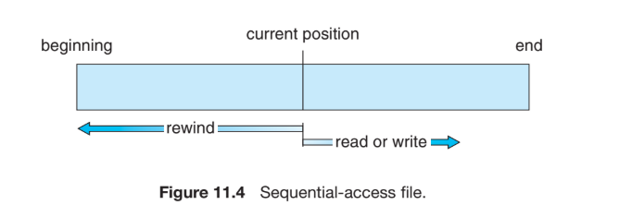
Access methods

Slide 19
Access methods
Direct Method
Direct access (or relative access) is a file access method where a file is treated as a set of fixed-length records/blocks, and any record can be read or written in any order. Since disks support random access, the system can directly jump to any block such as block 14, then block 53, and then write to block 7 without following sequence. This method is highly useful when quick access to specific information is needed.
Direct-access files are commonly used in databases and reservation systems. For example, in an airline reservation system, the details of flight 713 can be stored in block 713, so the system can directly access that block to check available seats. Similarly, for large datasets like customer details, the system may use a hash function or an in-memory index to locate the correct block quickly. File operations in direct access include read(n) and write(n), where n is the block number, or alternatively use position file(n) followed by read next().

Slide 20
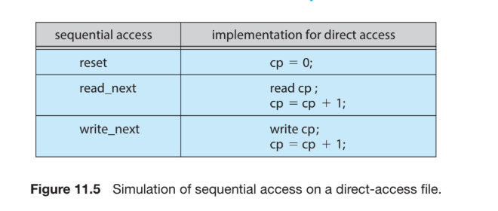
Access methods
Direct Method
Direct access (or relative access) is a file access method where a file is treated as a set of fixed-length records/blocks, and any record can be read or written in any order. Since disks support random access, the system can In direct access, the block number used is usually a relative block number, meaning it is counted from the start of the file (0, 1, 2, ...), not the actual physical disk address.
This helps the OS decide where to place the file and prevents users from accessing unauthorized disk areas. If each record has fixed length L, then record N is located at byte position L × N inside the file (assuming first record is N = 0). Sequential access can be easily simulated in direct access using a current pointer variable, but simulating direct access on a purely sequential file is inefficient.

Slide 21
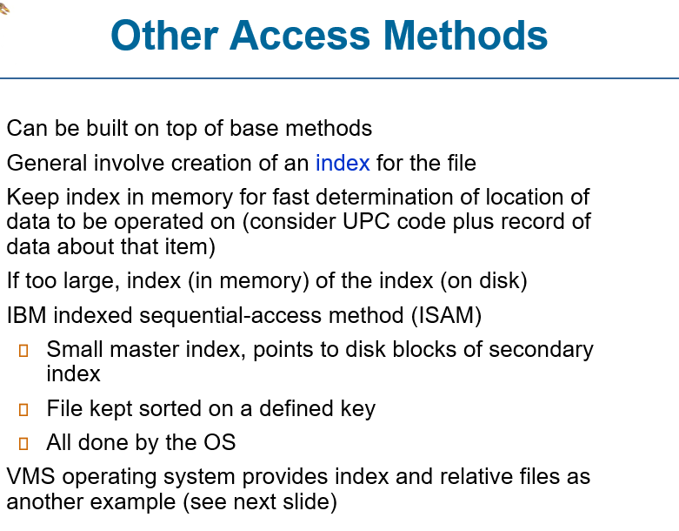
Access methods

Slide 22
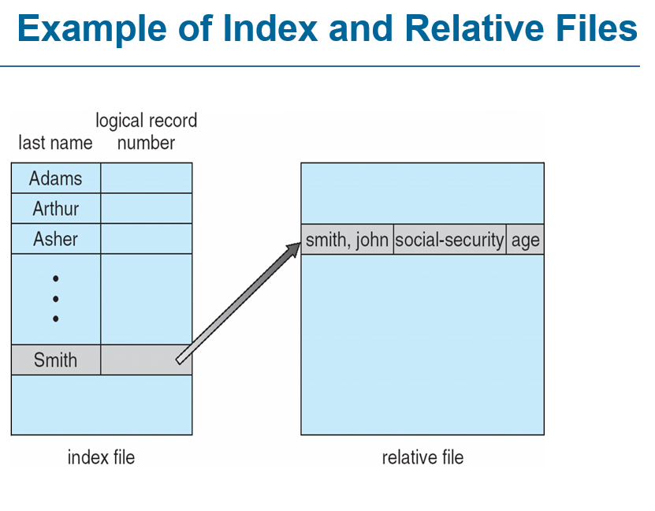
Access methods

Slide 23
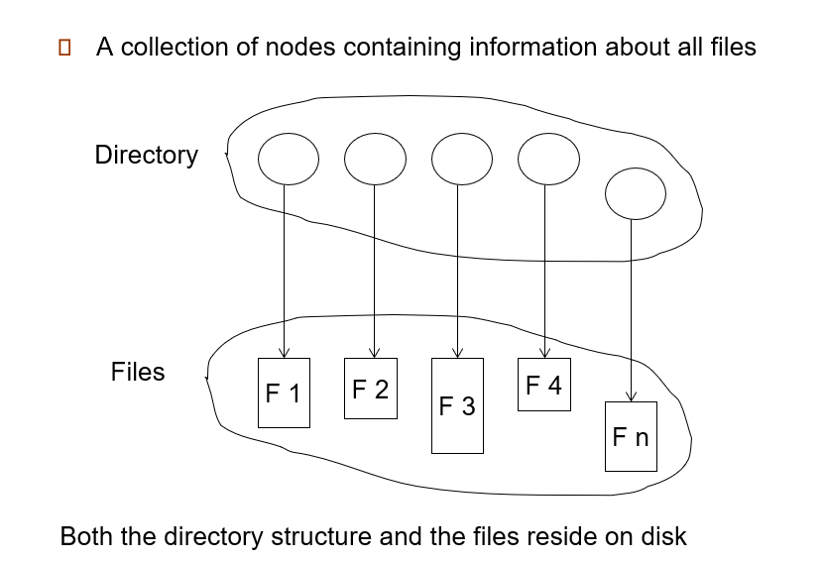
Disk and Directory Structures

Slide 24
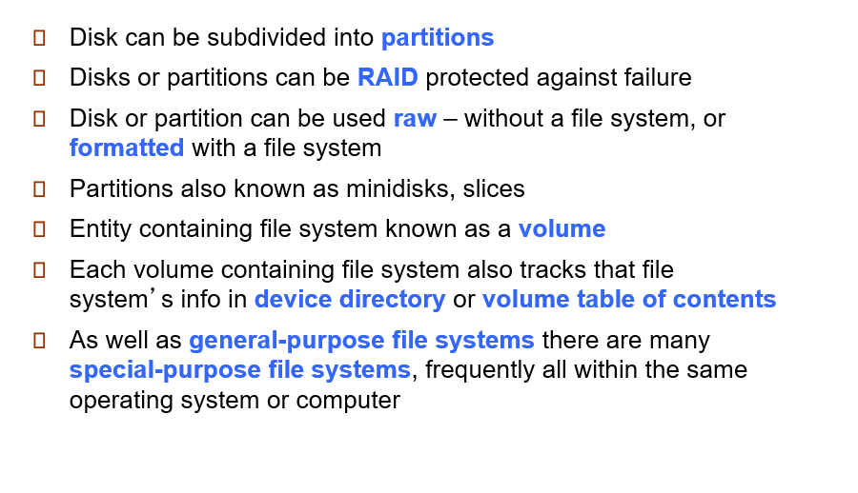
Disk and Directory Structures
Disk Structure

Slide 25
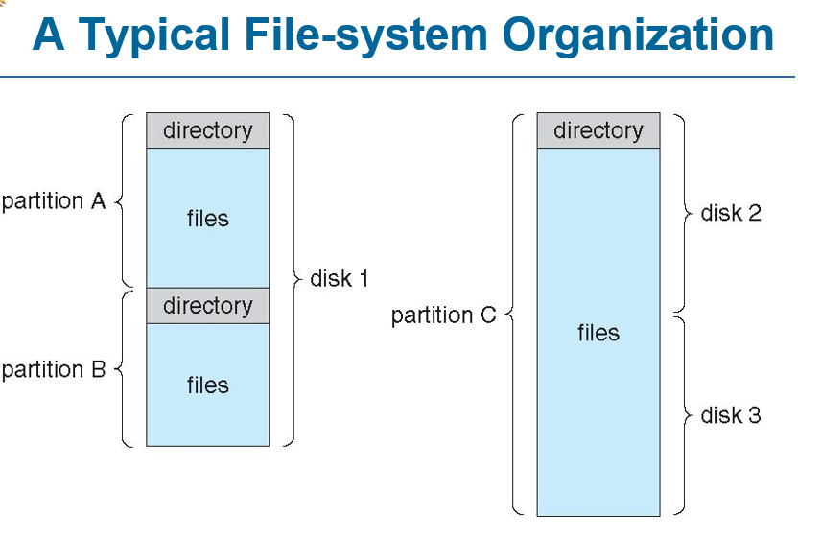
Disk and Directory Structures

Slide 26
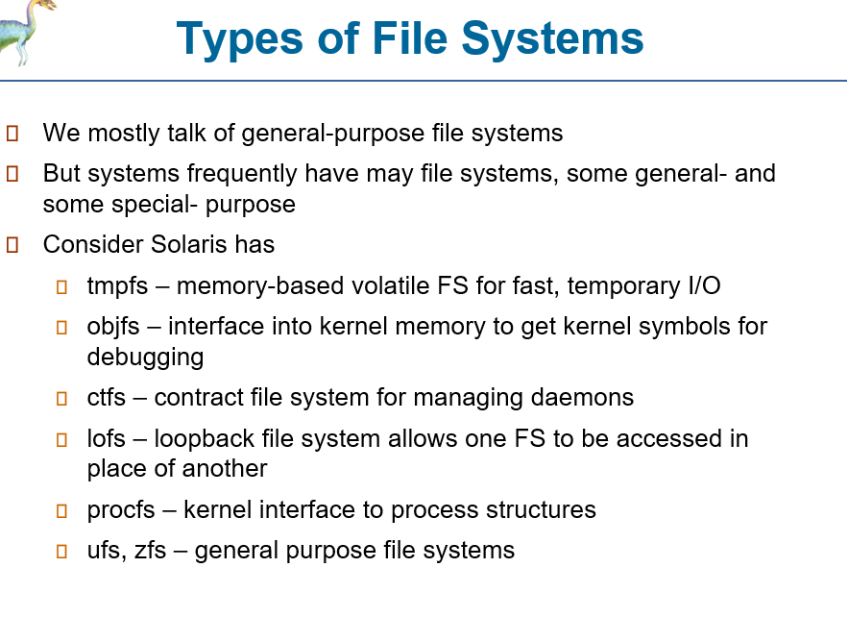
Disk and Directory Structures

Slide 27
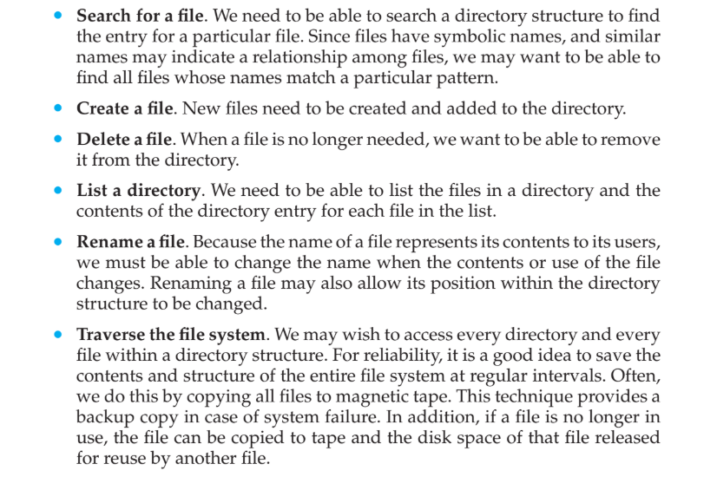
Disk and Directory Structures
Operations Performed on Directory

Slide 28
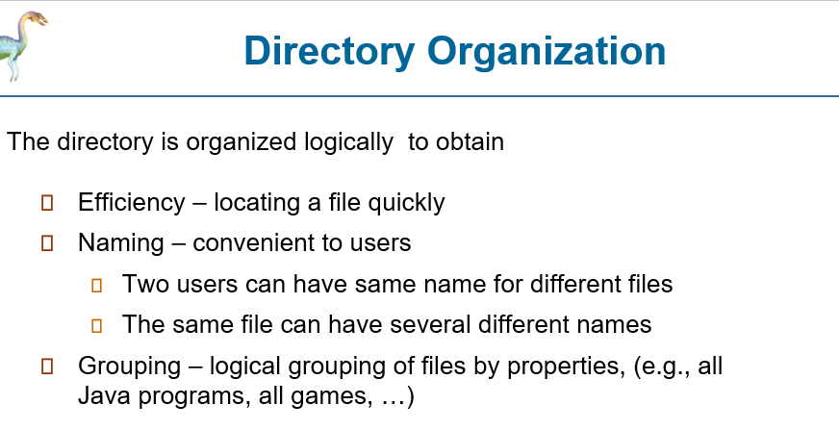

Slide 29
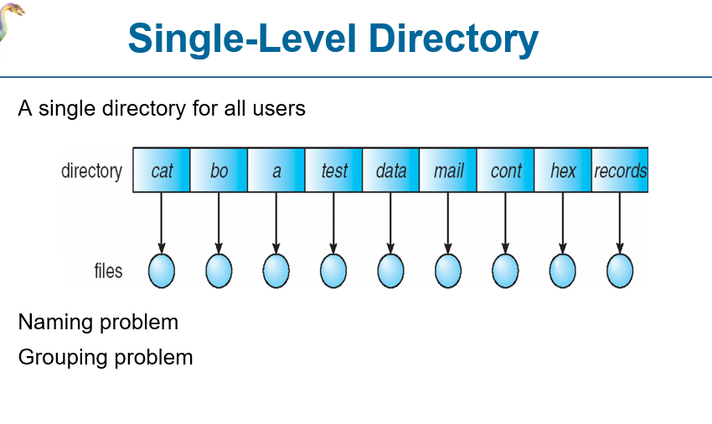

Slide 30
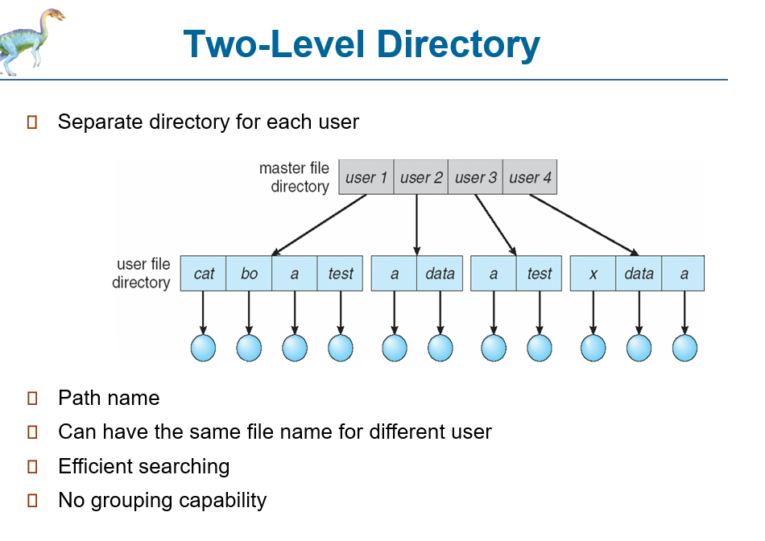

Slide 31
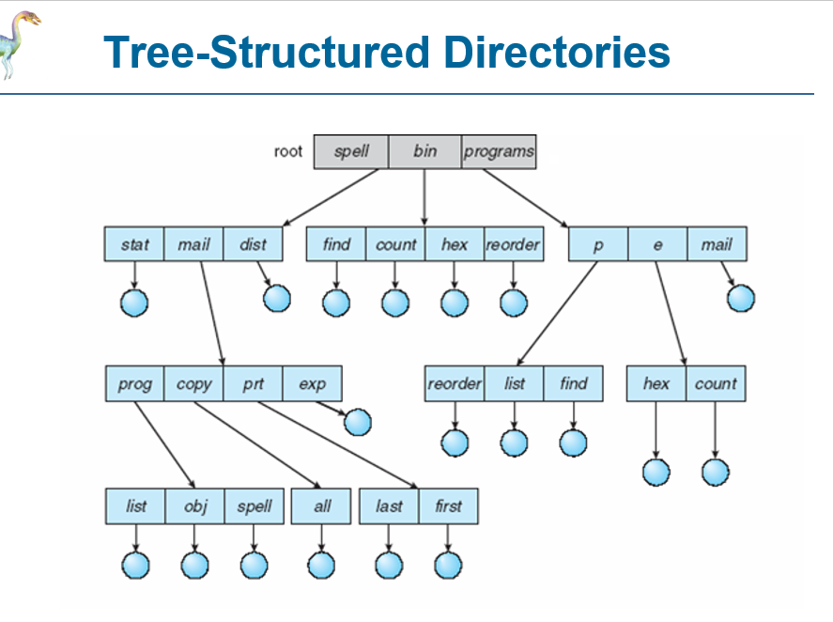

Slide 32
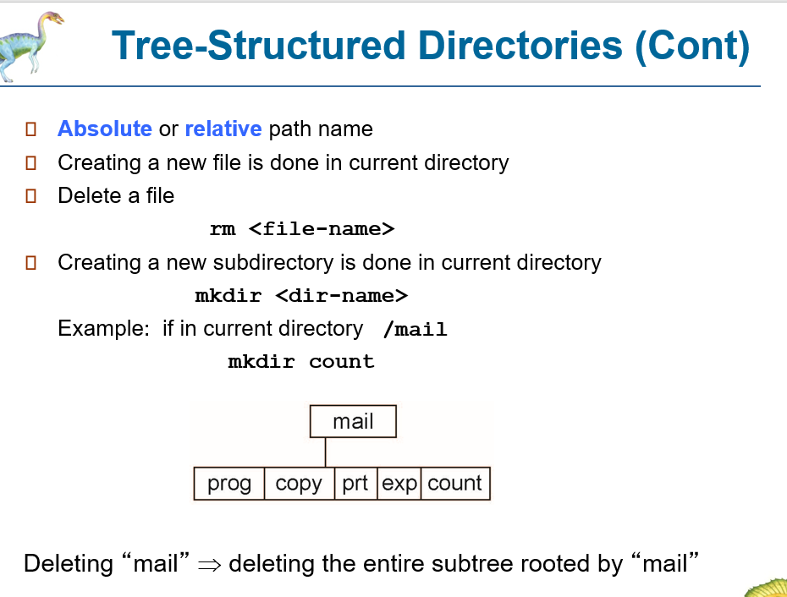

Slide 33
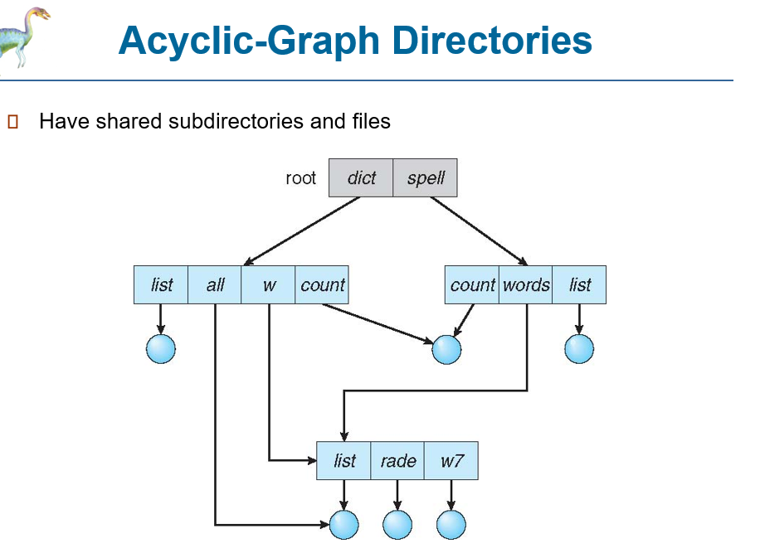

Slide 34
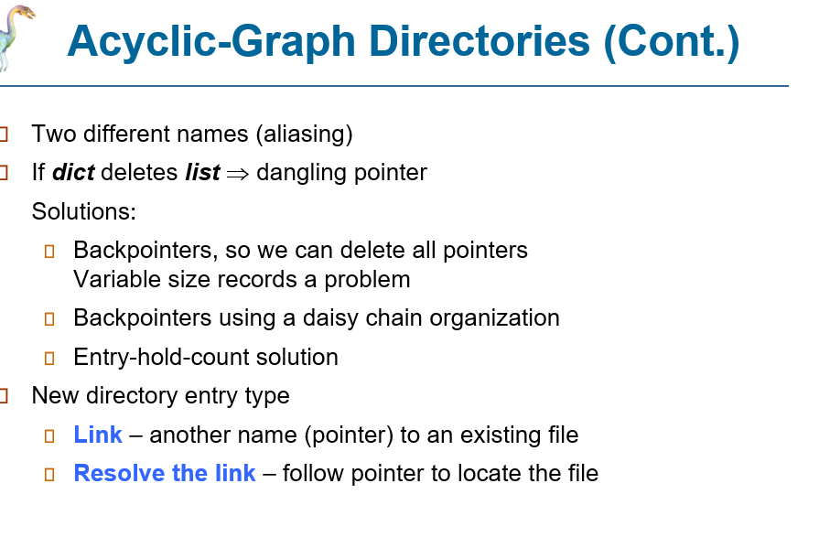

Slide 35
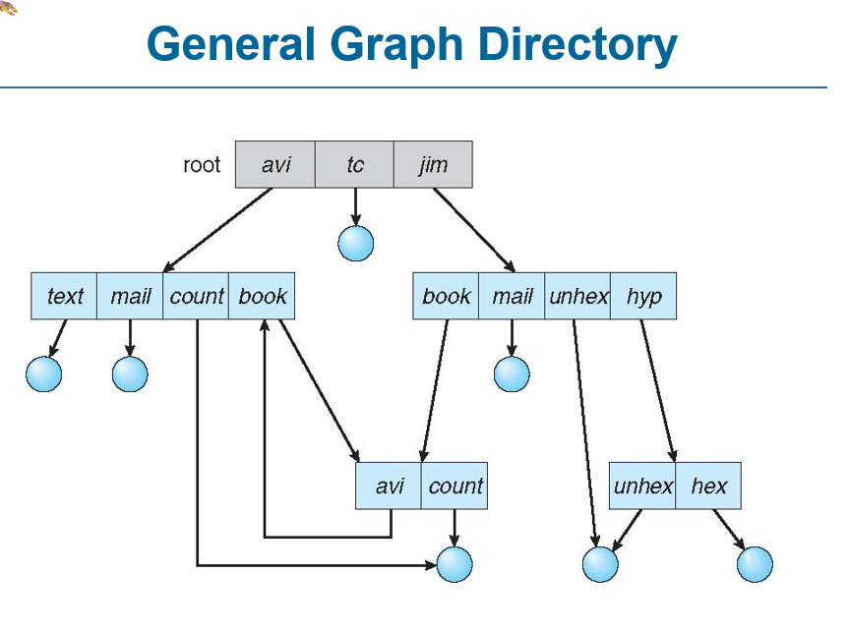

Slide 36
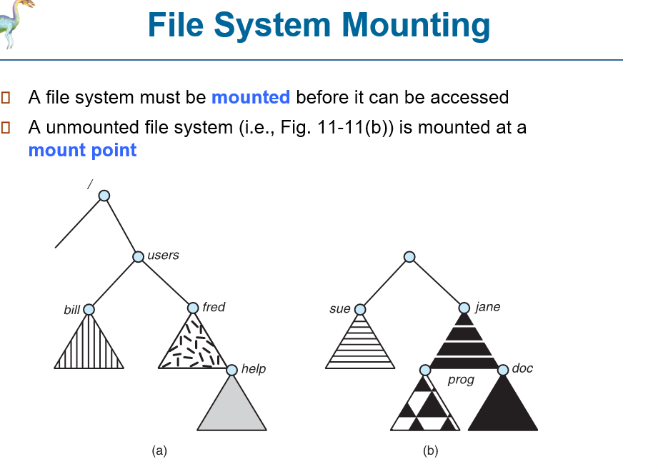
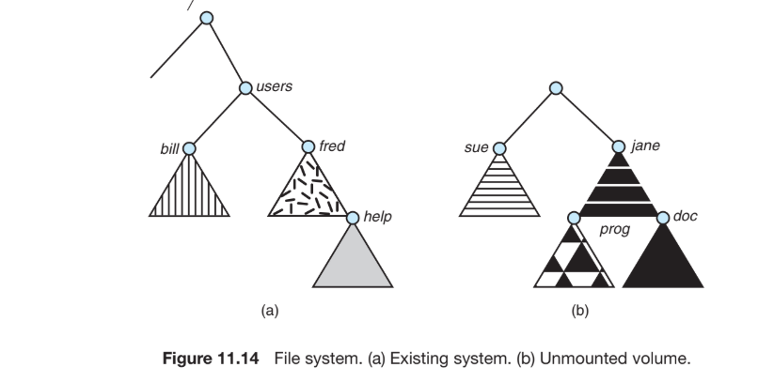

Slide 37
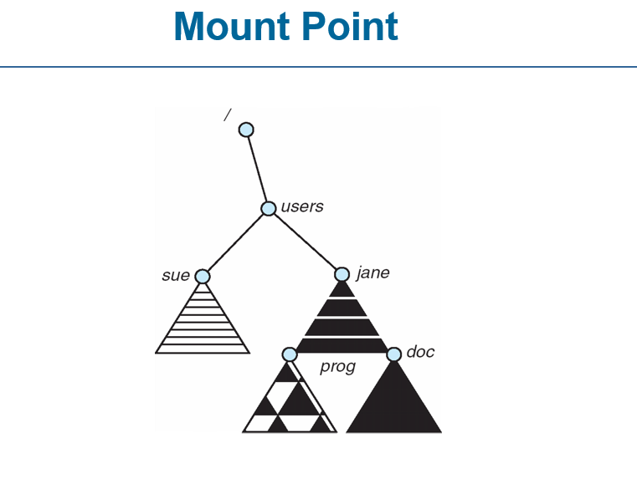
The operating system is given the name of the device and the mount point—the location within the file structure where the file system is to be attached.
Some operating systems require that a file system type be provided, while others inspect the structures of the device and determine the type of file system. Typically, a mount point is an empty directory.
For instance, on a UNIX system, a file system containing a user’s home directories might be mounted as /home; then, to access the directory structure within that file system, we could precede the directory names with /home, as in /home/jane.
Mounting that file system under /users would result in the path name /users/jane, which we could use to reach the same directory.

Slide 38
File Sharing
File Sharing in Multi user Operating System:
In a multiuser operating system, file sharing, file naming, and file protection become very important. Since many users may access the same directory structure, the OS must control how files are shared and accessed. The system must decide whether files are accessible to others by default or only when permission is granted.
This introduces access control and protection mechanisms. To support these features, the OS must store more file attributes than in a single-user system, so that it can correctly manage ownership, sharing, and permission enforcement.

Slide 39
File Sharing
Owner and Group Concept
Most modern operating systems use the concepts of file owner and group to manage sharing and protection. The owner is the user who has maximum control, including changing file attributes and granting permissions. The group represents a set of users who can share access to the file.
For example, in UNIX, the owner can perform all operations, group members can perform a limited subset, and all other users can perform another subset. The file owner defines exactly which operations are allowed for group members and others.

Slide 40
File Sharing
Permissions
The OS stores the owner ID and group ID along with other file attributes. When a user requests an operation (read/write/execute), the system compares the requesting user’s ID with the stored owner ID to check whether the user is the owner.
Similarly, the system compares the user’s group ID with the file’s group ID. Based on the match, the OS determines which permissions apply and either allows or denies the requested operation. This permission checking becomes straightforward once file systems are properly mounted.

Slide 41
File Sharing
Remote File Systems and File Sharing Methods
With the growth of computer networks, sharing files between remote computers became possible. Remote file systems allow users to access data stored on other machines across a campus or even across the world. File sharing through networks has evolved over time, and different techniques were introduced to improve accessibility and convenience.
The first method of remote file sharing was manual file transfer using programs like ftp (File Transfer Protocol). In this approach, users explicitly upload or download files from one system to another.
The second major method is the Distributed File System (DFS), where remote directories are made visible on a local system as if they are part of the local file system. The third method is the World Wide Web, which is similar to ftp in the sense that a browser is required and files are transferred separately. Today, cloud computing has also become widely used, where files are stored and accessed through online services.
ftp supports both anonymous access and authenticated access. Anonymous access allows users to download or upload files without having an account on the remote system, which is commonly used in the web. However, DFS provides deeper integration between client and server, allowing file operations like open, read, and write directly on remote files, making it more powerful but more complex.

Slide 42
File Sharing
Client–Server Model and Distributed Naming Services
Remote file systems generally work using the client–server model. The machine that stores and provides the files is called the server, and the machine that requests access is called the client. A server can provide file services to many clients, and similarly a client can access file systems from multiple servers. Usually, the server shares resources at the level of a directory or disk volume, not individual files.
Client identification is a major challenge in remote systems. A server may identify clients using network names or IP addresses, but these can be spoofed, meaning an attacker can imitate an authorized client. To improve security, systems may use encrypted authentication keys, but this creates challenges like compatibility (client and server must support same encryption algorithms) and secure key exchange (intercepted keys can lead to unauthorized access). Due to these difficulties, many systems still use less secure authentication methods.
For example, in UNIX Network File System (NFS), authentication is typically based on client-provided user ID information. This creates problems if user IDs differ between client and server. If a user has ID 1000 on the client but 2000 on the server, the server may wrongly check permissions using ID 1000, leading to incorrect access decisions. To solve such problems, distributed naming services like DNS (for host identification), NIS, CIFS Active Directory, and LDAP are used. LDAP is becoming the industry standard because it provides secure centralized authentication and can support single sign-on, where users log in once and gain access to multiple systems and resources.

Slide 43
File Sharing
Failure Modes
Remote file systems face more failure situations compared to local file systems because they depend on both the network connection and the remote server machine. In local file systems, failures may occur due to disk crashes, metadata corruption, controller failure, cable failure, or accidental deletion by users or administrators. Such failures often crash the system or display an error, and human intervention is usually required to fix the issue.
In remote file systems, failures are more frequent and complex. Problems may arise due to network partitioning, hardware faults in networking devices, server crashes, or scheduled shutdown of the server. A client might have remote files open and may be reading, writing, searching directories, or closing files. If the server suddenly becomes unreachable, the client cannot continue operations normally. Instead of treating it like a local disk crash, the system either terminates all operations or delays operations until the server becomes available again. Most DFS protocols prefer delaying operations because termination may lead to data loss and user frustration.

Slide 44
File Sharing
Consistency Semantics
To support recovery after failures, client and server may maintain state information about mounted file systems and open files. If both maintain state, they can resume smoothly after recovery. However, NFS originally followed a stateless design, meaning the server does not store information about which clients mounted files or which files are open. Every request sent by the client contains all required information to locate the file and perform the operation. This makes NFS simple and resilient, but it is less secure because forged requests might be accepted. Hence, NFS Version 4 introduced a more stateful approach to improve security, performance, and functionality.
Consistency semantics define how file updates made by one user become visible to other users in a shared environment. In UNIX semantics, changes made by one user are immediately visible to others who have the file open, and users may even share the same file pointer position. In Session semantics (Andrew File System), updates are not visible immediately; they become visible only after the file is closed and only for new sessions started later. This allows multiple users to work concurrently without delays. Another approach is Immutable shared file semantics, where once a file is shared, it cannot be modified and its name cannot be reused. This simplifies distributed sharing because all users only perform read operations, making consistency management easier.

Slide 45
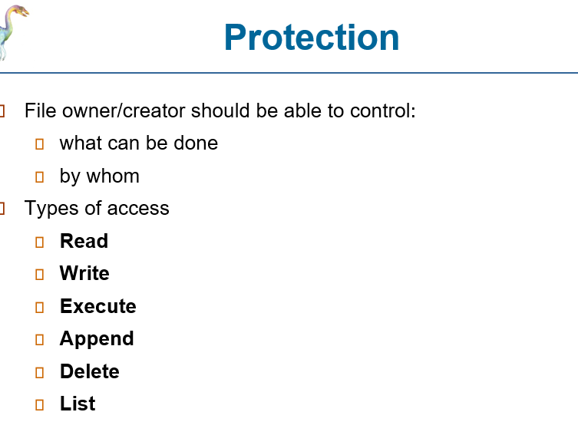
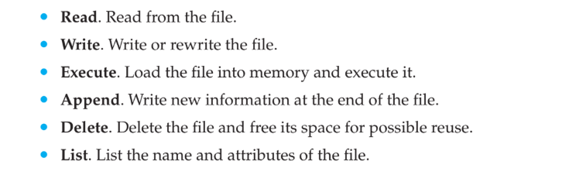
File Sharing

Slide 46
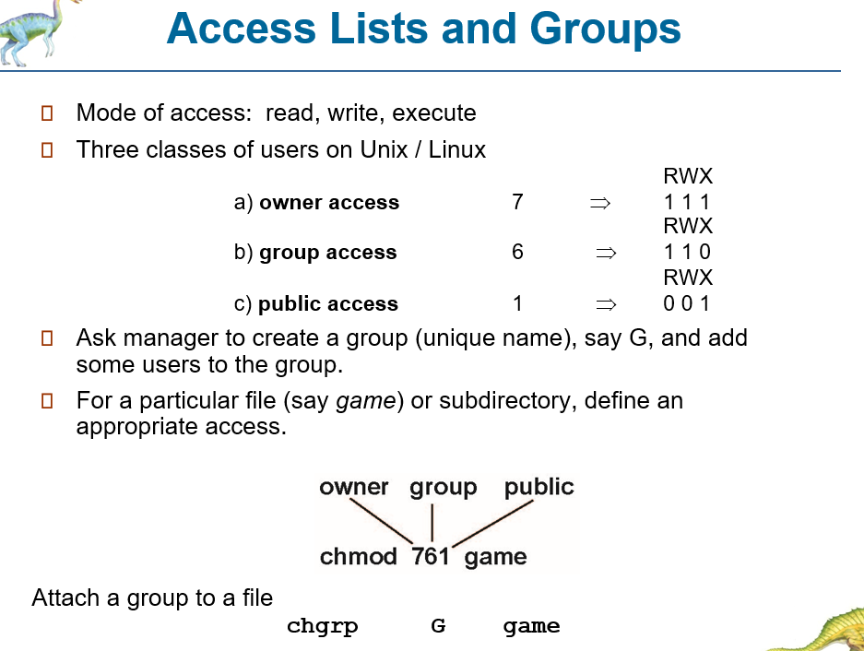
File Sharing

Slide 47
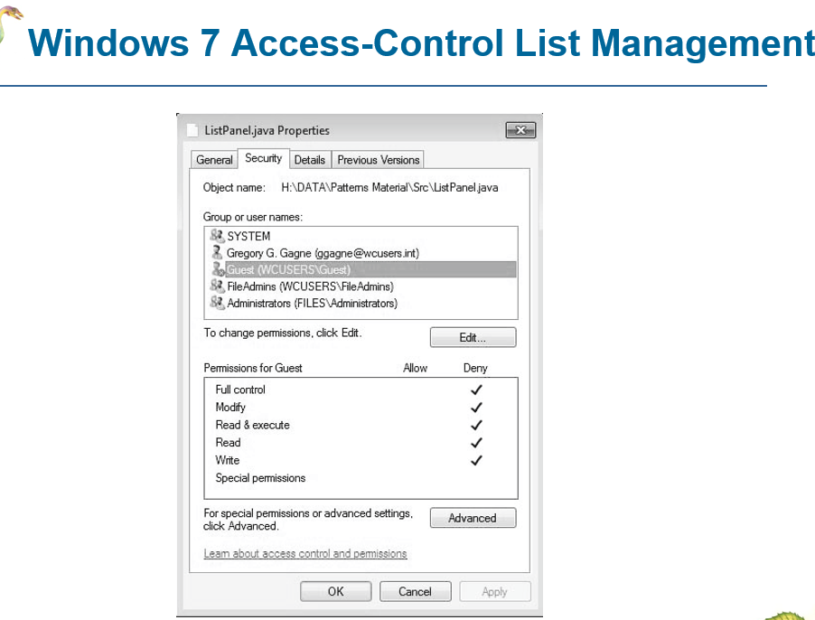
File Sharing

Slide 48
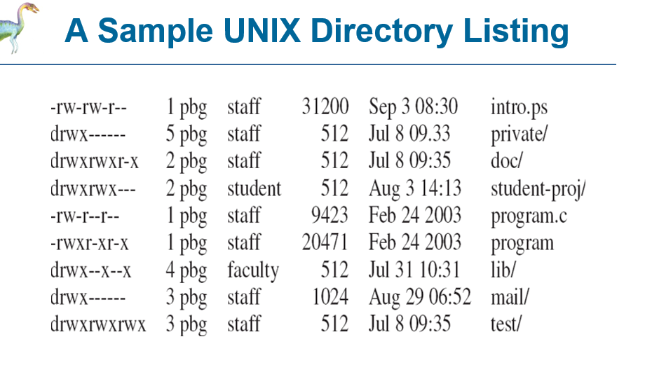
File Sharing

Slide 49
Protection
Goals of Protection:
Protection in computer systems became important as systems grew more complex and widely used. It was originally introduced in multiprogramming operating systems so that untrusted users could safely share common resources like file directories or memory. Today, protection is essential to maintain system integrity and reliability when multiple users and programs share resources. It prevents intentional violations of access restrictions and ensures that every program component uses system resources only according to defined rules. Protection also helps detect errors early at subsystem interfaces, preventing one faulty component from damaging others, and it allows the system to differentiate between authorized and unauthorized access.
The main role of protection is to provide mechanisms that enforce policies governing resource usage. These policies may be built into system design, set by system administrators, or defined by individual users to secure their own files and programs. Since policies vary across applications and can change over time, protection must be flexible and not limited only to OS designers—application developers also need to use protection mechanisms. A key concept is the separation of policy and mechanism: mechanisms define how protection is implemented, while policies decide what rules must be enforced. This separation ensures adaptability, since changing policies should not require redesigning the protection mechanisms.

Slide 50
Protection
Principles of Protection:
The principle of least privilege is a key protection guideline used in operating system design. It states that programs, users, and even systems should be given only the minimum privileges required to perform their tasks. This makes the system easier to design, consistent, and more secure. The idea is that limiting privileges reduces the possible damage caused by mistakes, misuse, or attacks.
For example, a security guard’s passkey should open only the public areas she must guard. If the key opens every area, then losing or misusing it can cause serious damage. Similarly, an OS that follows least privilege ensures that even if a component fails or is compromised, the attacker gains only limited access. For instance, a buffer overflow in a system daemon should not allow a remote user to execute privileged code and take full control of the system.
Such an OS provides fine-grained controls by offering mechanisms to enable privileges only when needed and disable them afterward. It also supports audit trails to track privileged operations for investigation. Least privilege is applied to user management through separate accounts and limited permissions, often using role-based access control (RBAC). Systems can also restrict computers to specific services, hosts, and times using service controls and access control lists. However, least privilege does not always guarantee security, as shown by Windows 2000 having many security holes despite strong protection mechanisms, while Solaris is considered more secure due to fewer services and possibly better-focused protection implementation.

Slide 51
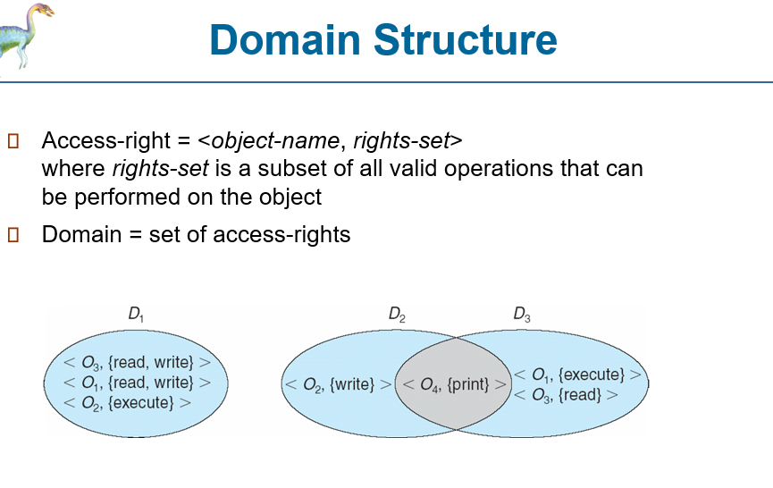
Protection

Slide 52
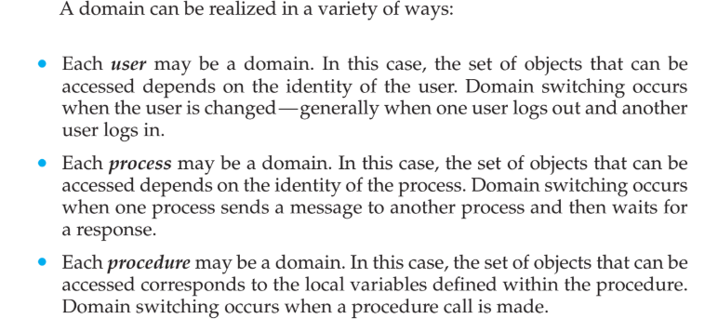
Protection

Slide 53
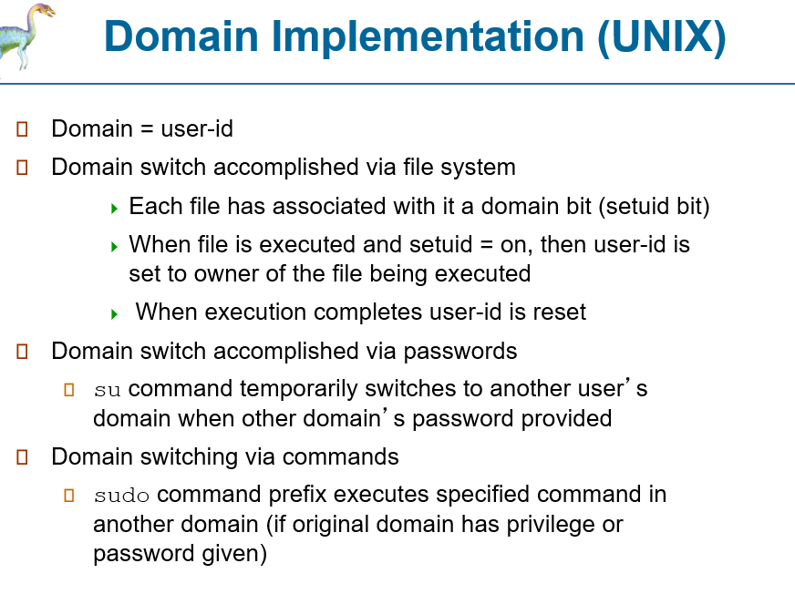
Protection

Slide 54
Protection
Domain Implementation(UNIX)
UNIX domain switching using setuid bit:
Each file has an owner ID and a setuid (domain) bit. If setuid is ON and a user executes the file, the process temporarily runs with the owner’s userID.
Example of userID change:
If user A runs a file owned by B:
setuid OFF → process userID stays A
setuid ON → process userID becomes B until the program finishes
Purpose of setuid mechanism:
It allows normal users to access privileged services (like networking) by running programs that temporarily switch to a privileged userID (often root).
Major security risk in UNIX:
If an attacker manages to create or exploit a file owned by root with setuid ON, they can gain root privileges and take full control of the system.
Alternative and more restrictive approaches:
Some OSs avoid setuid risks by using special privileged directories or by not allowing userID changes at all, instead using daemon processes to perform privileged tasks—but privileged programs must still be written carefully to avoid security breaches.

Slide 55
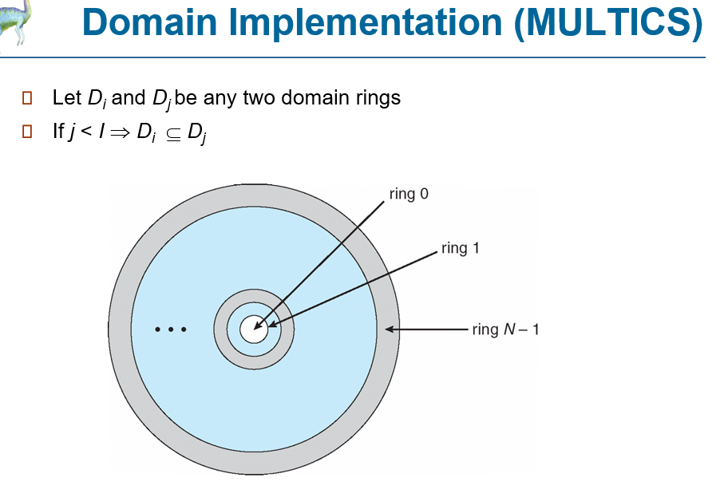
Protection
MULTICS organizes protection domains in a ring structure, where each ring represents a separate level of privilege.
Every memory segment is treated like a file, and each segment is assigned to a particular ring number.
Each segment contains three access bits that specify whether reading, writing, and execution are allowed.
The decision of which segment belongs to which ring is a policy matter, meaning it depends on system rules and administrator choices.
Each process maintains a current-ring-number counter, which indicates the ring in which the process is currently running.
If a process is executing in ring i, it is not allowed to access any segment belonging to ring j, where j < i, because those rings have higher privileges.
The process is allowed to access segments in ring k, where k ≥ i, but the actual operations allowed depend strictly on the segment’s access bits.
Domain switching occurs when a process calls a procedure located in another ring, causing it to move from one ring to another. Such switching must be carefully controlled, otherwise a process could jump into ring 0 and gain full system privileges, breaking protection completely.

Slide 56
Protection

Slide 57
Protection
To allow controlled domain switching, we modify the ring field of the segment descriptor to include the following:
• Access bracket. A pair of integers, b1 and b2, such that b1 ≤ b2.
• Limit. An integer b3 such that b3 > b2.
• List of gates. Identifies the entry points (or gates) at which the segments may be called.
If a process executing in ring i calls a procedure (or segment) with access bracket (b1,b2), then the call is allowed if b1 ≤ i ≤ b2, and the current ring number of the process remains i. Otherwise, a trap to the operating system occurs, and the situation is handled as follows:
• If i < b1, then the call is allowed to occur, because we have a transfer to a ring (or domain) with fewer privileges. However, if parameters are passed that refer to segments in a lower ring (that is, segments not accessible to the called procedure), then these segments must be copied into an area that can be accessed by the called procedure.
• If i > b2, then the call is allowed to occur only if b3 is greater than or equal to i and the call has been directed to one of the designated entry points in the list of gates. This scheme allows processes with limited access rights to call procedures in lower rings that have more access rights, but only in a carefully controlled manner.

Slide 58
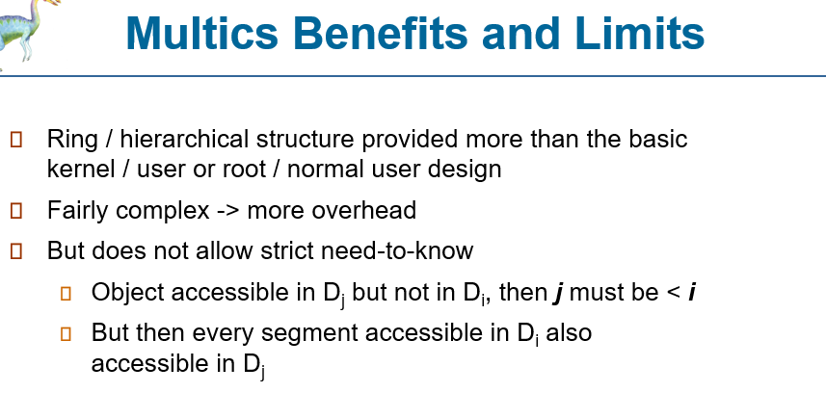
Protection

Slide 59
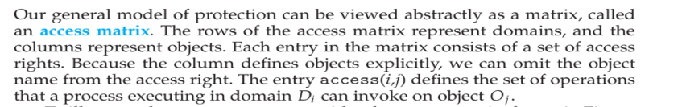
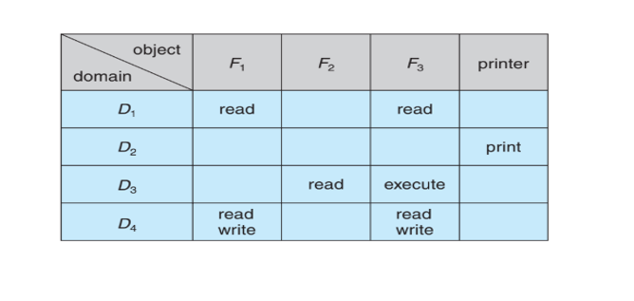
Protection: Access Matrix
we consider the access matrix shown in Figure 14.3. There are four domains and four objects—three files (F1, F2, F3) and one
laser printer. A process executing in domain D1 can read files F1 and F3.A process executing in domain D4 has the same privileges as one executing in domain D1; but in addition, it can also write onto files F1 and F3. The laser printer can be accessed only by a process executing in domain D2.

Slide 60
Protection: Access Matrix
The access-matrix scheme provides a general mechanism for defining different protection policies by specifying what actions (rights) each domain can perform on each object. The system must ensure that a process running in domain Di can access only the objects listed in row i, and only with the rights permitted in the corresponding access-matrix entries. The main policy decisions involve selecting which rights should be included in each (i, j) entry and deciding the domain in which each process will execute (usually determined by the operating system). Users normally control the contents of the access matrix; when a user creates a new object Oj, a new column is added and initialized with rights chosen by the creator, who may assign different rights to different domains as needed.
The access matrix also supports both static and dynamic control of how processes relate to domains. Domain switching is treated as an operation performed on an object (the domain), so domains themselves can be included as objects in the matrix to control switching. Similarly, changes to the access matrix are operations on an object, so the access matrix (and even each individual entry) must be protected as well. Processes are allowed to switch from domain Di to domain Dj only if the right switch is present, meaning switching is permitted if and only if: switch ∈ access(i, j).

Slide 61
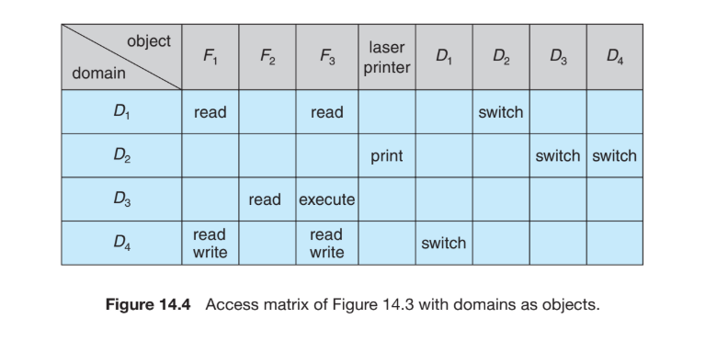
Protection: Access Matrix

Slide 62
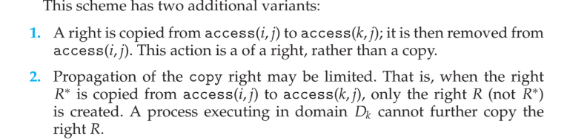
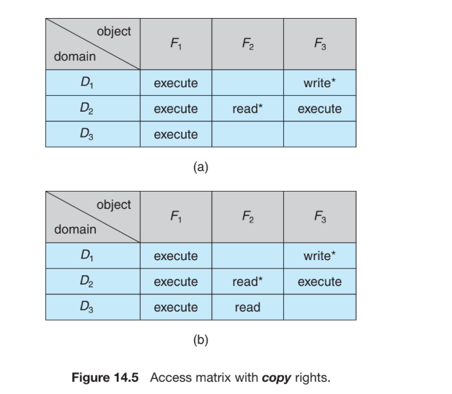
Protection: Access Matrix

Slide 63
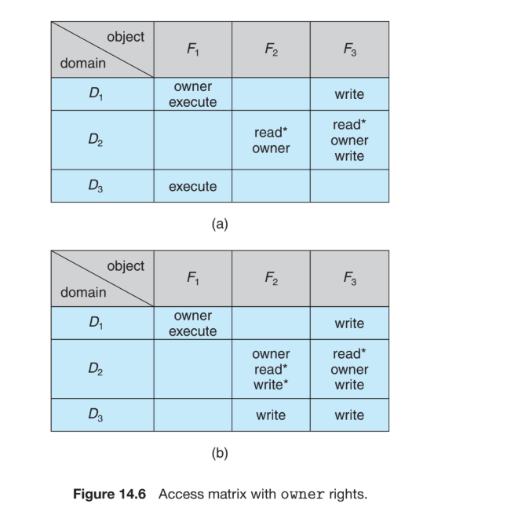
Protection: Access Matrix
Copy and owner rights can restrict how access rights are shared, but they cannot stop information leakage, meaning they do not prevent disclosure of data.
The challenge of ensuring that information inside an object never escapes its environment is called the confinement problem, and it is generally unsolvable.
Operations on domains and the access matrix may not be important by themselves, but they show that the access-matrix model supports dynamic protection by allowing controlled changes in rights and domains.

